Slide 1
House Price Analysis & Prediction
Name: Reethika Kalvacherla
Role: Data Science Intern
Date: 06/04/2026

Slide 2
Problem Statement
Real estate pricing is often inaccurate
Difficult to identify key price factors
Leads to poor investment decisions

Slide 3
Objectives
Analyze price factors
Identify trends
Build prediction model
Provide recommendations

Slide 4
Dataset Overview
House price dataset
300+ rows
Features: Area, Bedrooms, Price

Slide 5
Approach
Data Cleaning
Exploratory Data Analysis (EDA)
Correlation Analysis
Regression Modeling
Insights & Recommendations

Slide 6
Data Cleaning
Handled missing values
Removed duplicates
Converted data types

Slide 7
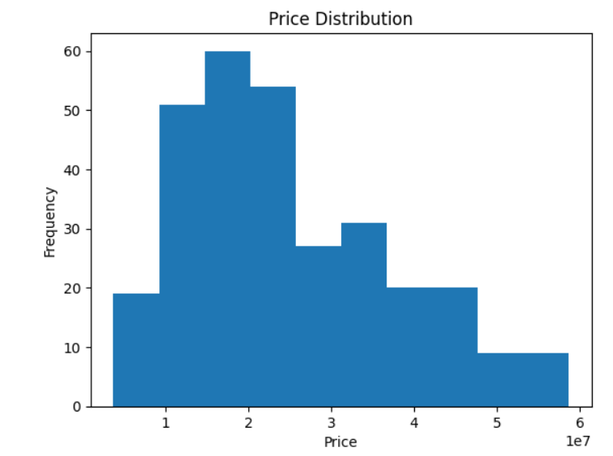
Price Distribution
Most houses fall within a specific price range
Some high-value outliers observed

Slide 8
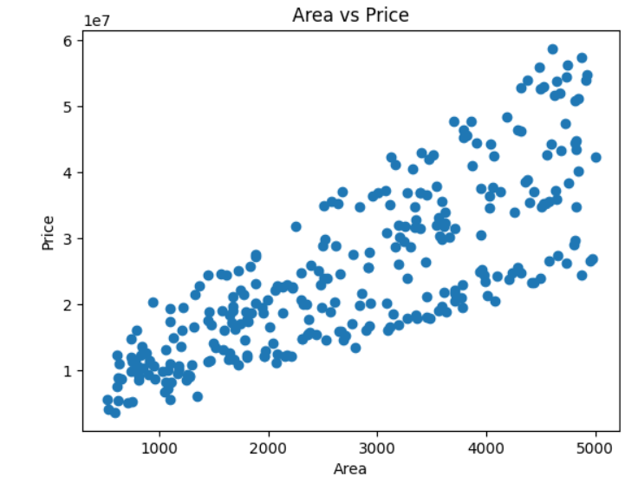
Area vs Price
Strong positive relationship
Larger houses → higher price

Slide 9
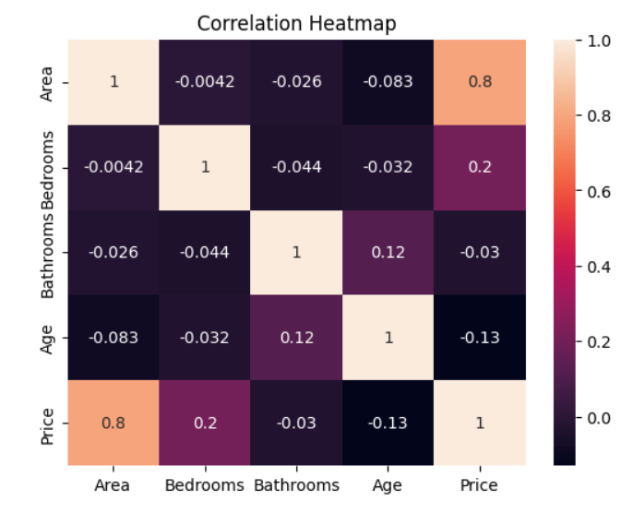
Correlation Heatmap
Area highly correlated with price
Other features show moderate impact

Slide 10
Model Building
Used Linear Regression
Trained on 80% data
Tested on 20% data

Slide 11
Model Performance
Mean Absolute Error: 6008382.406257718
R2 Score: 0.5986323407470491

Slide 12
Key Insights
Area is the most important factor
Larger homes have higher value
Some features have low impact
Outliers exist in pricing

Slide 13
Recommendations
Focus on larger properties for higher ROI
Invest in high-demand areas
Use data-driven pricing models
Avoid overpricing low-feature houses

Slide 14
Business Impact
Better pricing accuracy
Improved investment decisions
Increased profitability
Reduced risk

Slide 15
Conclusion
Data analysis improves decision-making
Predictive models help estimate prices
Insights can guide real estate strategy

Slide 16
Thank You

